Slide 1




FIFA World Cup Analysis
Dive into the captivating history, dynamic tournament structure, and global impact of the FIFA World Cup, the most prestigious international football competition.
by Nikhil Yadav

Slide 2

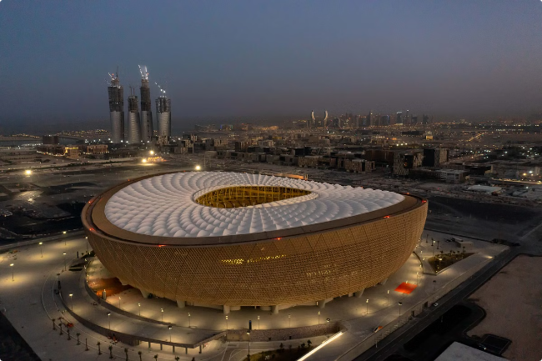
Introduction to the World Cup
1
World's Largest Sports Event
2
National Team Competition
The FIFA World Cup is the most widely viewed and followed sporting event in the world, with billions of fans tuning in globally.
The World Cup features the top national football teams from around the world competing for the coveted trophy.
3
Football's Biggest Stage
The World Cup provides the ultimate platform for the world's best players to showcase their skills on the international stage.

Slide 3

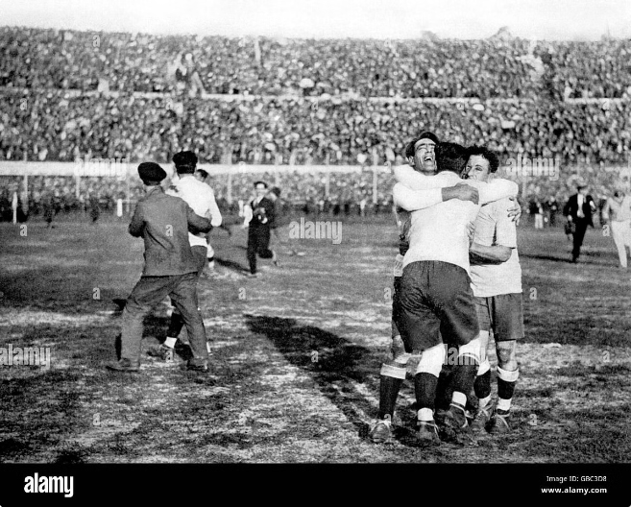
Historical Overview (1930-2014)
1
1930-1962
The early years saw Uruguay, Italy, and Brazil establish dominance, with the competition expanding from 13 to 16 teams.
2
1966-1986
England, Germany, and Argentina emerged as powerhouses, with the tournament growing to 24 teams by 1982.
3
1990-2014
The modern era witnessed the continued success of Brazil and the rise of new champions like Italy, France, and Spain.

Slide 4
Tournament Format and Structure
Qualification
Group Stage
Knockout Rounds
National teams must first qualify through continental tournaments to earn a spot in the World Cup finals.
The 32 qualified teams are divided into 8 groups of 4, playing each other in a round-robin format.
The top 2 teams from each group advance to a 16-team, single-elimination playoff to determine the champion.

Slide 5

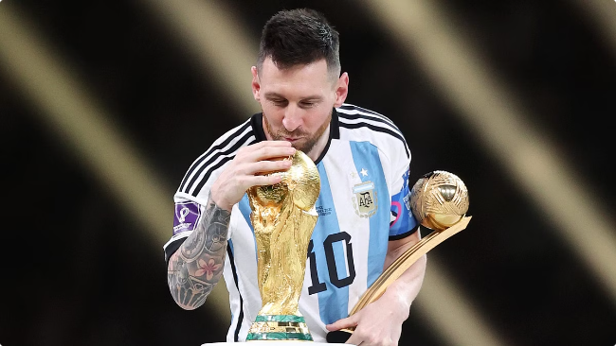
Top Performing Teams and Players
Most Titles
Most Appearances
Brazil and Germany have each won the World Cup a record 5 times.
Germany, Italy, and Brazil have each reached the World Cup finals the most often, with 8 appearances each.
Top Scorers
Best Players
Germany's Miroslav Klose holds the record for most goals scored in World Cup history with 16.
Legends like Pele, Diego Maradona, and Lionel Messi have cemented their legacies through iconic World Cup performances.

Slide 6





Trends and Patterns in World Cup Outcomes
Dominant Dynasties
Cinderella Stories
Home Advantage
Penalty Shootout Drama
Brazil, Germany, and Italy have won the majority of World Cups, showcasing their sustained excellence.
Underdogs like Uruguay, Croatia, and Senegal have occasionally shocked the world with unexpected deep runs.
Host nations have won the World Cup 6 times, benefiting from passionate local support.
Nail-biting penalty shootouts have often determined the outcome of World Cup matches and even finals.

Slide 7




Impact of the World Cup on Global Football
Increased Popularity
Talent Development
Economic Boost
The World Cup has exponentially grown football's global fanbase and inspired millions to play the game.
The tournament provides a platform for young stars to showcase their skills and accelerate their careers.
Hosting the World Cup can generate significant economic activity and investment for the host nation.

Slide 8


Conclusion and Key Takeaways
The FIFA World Cup is the pinnacle of international football, captivating billions with its drama, passion, and unparalleled spectacle.
From the early dominance of powerhouses to the emergence of new champions, the World Cup has evolved into a truly global event.
The tournament's impact extends far beyond the field, shaping the sport's popularity, talent development, and economic landscape worldwide.

